Slide 1
Android Testing
Basics and Beyond
Presented by:
Dinkar Kumar
Notes:
Intro, welcome and other PMD things

Slide 2
Agenda
Why testing ?
Unit testing.
Test Doubles.
Instrumented unit test.
Integration test (Espresso).
UI Automator.
Demos (wherever needed)

Slide 3
Why testing ?

Slide 4
Why testing?
According to Cambridge University research in 2012, the global cost of debugging the software has risen to $312 billion annually.
The research found that, on average, software development spend 50% of their programming time finding and fixing bugs

Slide 5
Why testing?
Deeper and better understanding of requirement
Increase reliability and robustness
Customer satisfaction
Reduce maintenance cost

Slide 6

Testing Pyramid

Slide 7
Unit test
Using JUnit and Mockito

Slide 8
Unit testing
Unit testing is a software development process in which the smallest testable parts of an application, called units, are individually and independently scrutinized for proper operation.

Slide 9
Benefits of Unit testing
Find problems early
Promote change
Simplifies integration
Documentation
Design

Slide 10
JUnit
JUnit is a simple framework to write repeatable tests. It is an instance of the xUnit architecture for unit testing frameworks.
@Test
public void newArrayListsHaveNoElements()
{
assertThat(new ArrayList().size(), is(0));
}

Slide 11
JUnit basic annotations
@BeforeClass – Run once before any of the test methods in the class, public static void
@AfterClass – Run once after all the tests in the class have been run, public static void
@Before – Run before @Test, public void
@After – Run after @Test, public void
@Test – This is the test method to run, public void

Slide 12
JUnit
Gradle command to run unit test: ./gradlew test
Demo

Slide 13
Test doubles
Generic not specific to android

Slide 14
Test doubles
A test double is an object that can stand in for a real object in a test
It is similar to how a stunt double stands in for an actor in a movie.
These are sometimes all commonly referred to as “mocks”
The most common types of test doubles are
Dummy
Stub
Spy
Fake.
Mock

Slide 15
Test doubles
Lets take one example to illustrate all the test doubles
We have a EmployeeServcie class which will do some action like creating customers on basis of their authorizations
Pojo | DAO | Service
Customer | IEmployeeDAO | EmployeeService
Employee | EmployeeDAO

Slide 16
Dummy
Dummy object used when a object is needed for the tested method but without actually needing to use the object.

Slide 17
Stub
A stub has no logic, and only returns what you tell it to return. Stubs can be used when you need an object to return specific values in order to get your code under test into a certain state.

Slide 18
Spy
Spies are stubs that also record some information based on how they were called. One form of this might be an email service that records how many messages it was sent.

Slide 19
Mock
Mocks are pre-programmed with expectations which form a specification of the calls they are expected to receive.
They can be checked during verification to ensure they got all the calls they were expecting.

Slide 20
Fake
Fake objects actually have working implementations, but usually take some shortcut which makes them not suitable for production (an InMemoryTestDatabase is a good example).
Notes:
Use case of fake to create fake service

Slide 21
Mockito
Mockito is an open source testing framework for Java. The framework allows the creation of test double objects that is used for effective unit testing of Java applications.

Slide 22
Mockito basic annotation
@Mock : It is used to create dummy instance
@Mock
List<String> mockedList;
@Spy : It is used to spy on an existing instance
@Spy
List<String> spiedList = new ArrayList<String>();

Slide 23
Test double with Mockito
Demo

Slide 24
Instrumented Unit test

Slide 25
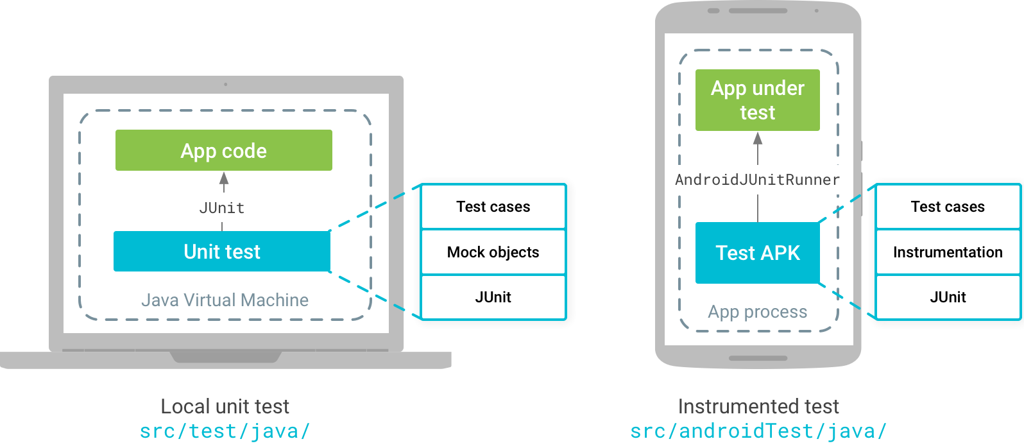

Slide 26
Instrumented unit test
Instrumented unit tests are tests that run on physical devices and emulators
It can take advantage of the Android framework APIs and supporting APIs, such as the Android Testing Support Library.
We should create instrumented unit tests if our tests require the real implementation of an Android framework component (such as a Parcelable,SharedPreference).

Slide 27
Instrumented unit test
Demo

Slide 28
Integration Testing
Espresso

Slide 29

Espresso
Espresso is testing framwork for integration testing to simulate user interactions within a single target app
Requires Android 2.2 (API level 8) or higher.

Slide 30
Espresso packages
espresso-core - Contains core and basic View matchers, actions, and assertions.
espresso-web - Contains resources for WebView support.
espresso-idling-resource - Espresso’s mechanism for synchronization with background jobs.
espresso-contrib - External contributions that contain DatePicker, RecyclerView and Drawer actions, Accessibility checks, and CountingIdlingResource.
espresso-intents - Extension to validate and stub Intents, for hermetic testing.

Slide 31
Espresso setup instructions
Setup your test environment
To avoid flakiness, we highly recommend that you turn off system animations on the virtual or physical device(s) used for testing.
On your device, under Settings->Developer options disable the following 3 settings:
Window animation scale
Transition animation scale
Animator duration scale

Slide 32
Espresso setup instructions cont.
Download Espresso
Make sure you have installed the latest Android Support Repository under Extras in SDK Manager.
Open your app’s build.gradle file.
Add the following lines inside dependencies:
androidTestCompile 'com.android.support.test.espresso:espresso-core:2.2.2'
androidTestCompile 'com.android.support.test:runner:0.5'

Slide 33
Espresso setup instructions cont.
Set the instrumentation runner
Add to the same build.gradle file the following line in android.defaultConfig:
testInstrumentationRunner "android.support.test.runner.AndroidJUnitRunner"

Slide 34
Espresso setup instructions cont.
Running tests
In Android Studio
Create a test configuration
Open Run menu -> Edit Configurations
Add a new Android Tests configuration
Choose a module
Add a specific instrumentation runner:
android.support.test.runner.AndroidJUnitRunner
Run the newly created configuration.
From command-line via Gradle
Execute
./gradlew connectedAndroidTest

Slide 35
Espresso Basics
Demo

Slide 36
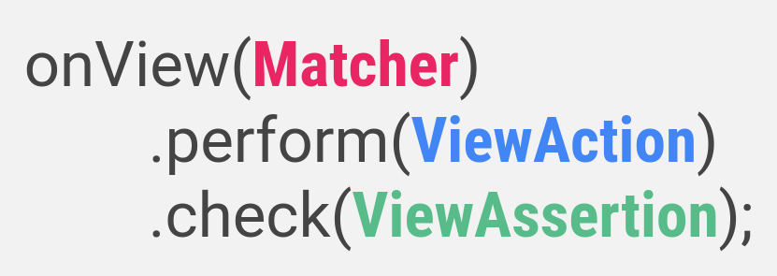
Main components of Espresso

Slide 37
Main components of Espresso
Espresso – Entry point to interactions with views (via onView and onData).
ViewMatchers – A collection of objects that implement Matcher<? super View> interface(like ‘withId’).
ViewActions – A collection of ViewActions that can be passed to the ViewInteraction.perform() method (like ‘click’).
ViewAssertions – A collection of ViewAssertions that can be passed the ViewInteraction.check() method(like 'matches').

Slide 38
Espresso Basic test
Click on the button
The first step is to look for a property that helps to find the button.
onView(withId(R.id.button_simple))
Now to perform the click:
onView(withId(R.id.button_simple)).perform(click());

Slide 39
Espresso Basic test cont.
Check that the TextView now contains “Hello Espresso!”
The TextView with the text to verify has a unique R.id too:
onView(withId(R.id.text_simple))
Now to verify the content text:
onView(withId(R.id.text_simple)).check(matches(withText("Hello Espresso!")));

Slide 40
Espresso Intents
Espresso-Intents is an extension to Espresso, which enables validation and stubbing of Intents sent out by the application under test. It’s like Mockito, but for Android Intents.

Slide 41
Espresso Intents cont.
Download Espresso-Intents
Add the following line inside dependencies:
androidTestCompile 'com.android.support.test.espresso:espresso-intents:2.2.2’
Espresso-Intents is only compatible with Espresso 2.1+ and the testing support library 0.3 so make sure you update those lines as well:
androidTestCompile 'com.android.support.test:runner:0.5'
androidTestCompile 'com.android.support.test:rules:0.5'
androidTestCompile 'com.android.support.test.espresso:espresso-core:2.2.2'

Slide 42
Espresso Intents cont.
IntentsTestRule
Use IntentsTestRule instead of ActivityTestRule when using Espresso-Intents.
IntentsTestRule makes it easy to use Espresso-Intents APIs in functional UI tests.
This class is an extension of ActivityTestRule.

Slide 43
Espresso Intents cont.
Demo

Slide 44
Espresso Intents cont.
Intent validation
Espresso-Intents records all intents that attempt to launch activities from the application under test.
Using the intended API (cousin of Mockito.verify), you can assert that a given intent has been seen.
An example test that simply validates an outgoing intent:
intended(toPackage("com.android.phone"));

Slide 45
Espresso Intents cont.
Intent stubbing
Using the intending API (cousin of Mockito.when), you can provide a response for activities that are launched with startActivityForResult
An example test with intent stubbing:
intending(toPackage("com.android.contacts")).respondWith(new ActivityResult()));

Slide 46
Espresso Intents cont.
Intent matchers
These are the matchers used in intending and intended methods.
hasAction
hasCategories
hasExtras
toPackage

Slide 47
UI Automator

Slide 48
UI Automator
The UI Automator testing framework provides a set of APIs to build UI tests that perform interactions on user apps and system apps.
The UI Automator APIs allows you to perform operations such as opening the Settings menu or the app launcher in a test device.
The UI Automator testing framework is well-suited for writing black box-style automated tests.

Slide 49
UI Automator key features
A viewer to inspect layout hierarchy.
An API to retrieve state information and perform operations on the target device.
APIs that support cross-app UI testing.
Requires Android 4.3 (API level 18) or higher.

Slide 50
UI Automator setup
In the build.gradle file of your Android app module, you must set a dependency reference to the UI Automator library:
dependencies {
...
androidTestCompile 'com.android.support.test.uiautomator:uiautomator-v18:2.1.1'
}

Slide 51
UI Automator
Demo

Slide 52
UI Automator key features cont.
UI Automator Viewer
The uiautomatorviewer tool provides a convenient GUI to scan and analyze the UI components currently displayed on an Android device.
It is used to view the properties of UI components that are visible on the foreground of the device.
The uiautomatorviewer tool is located in the <android-sdk>/tools/ directory.

Slide 53
UI Automator key features cont.
Access to device state
This framework provides a UiDevice class to access and perform operations on the device on which the target app is running.
Change the device rotation
Press a D-pad button
Press the Back, Home, or Menu buttons
Open the notification shade
Take a screenshot of the current window

Slide 54
UI Automator key features cont.
UI Automator APIs
The UI Automator APIs allow you to write robust tests without needing to know about the implementation details of the app that you are targeting.
UiObject: Represents a UI element that is visible on the device.
UiScrollable: Provides support for searching for items in a scrollable UI container.
UiSelector: Represents a query for one or more target UI elements on a device.

Slide 55
Monkey
The Monkey generates pseudo-random streams of user events such as clicks, touches, or gestures, as well as a number of system-level events.
We can use the Monkey to stress-test applications that you are developing, in a random yet repeatable manner.
The basic syntax is:
$ adb shell monkey [options] <event-count>
Example :
$ adb shell monkey -p your.package.name -v 500

Slide 56
Q & A

Slide 57


Slide 58
Demo Repository
https://github.com/dinkar19121991/AndroidTesting

Slide 59
References
https://8thlight.com/blog/uncle-bob/2014/05/14/TheLittleMocker.html
https://google.github.io/android-testing-support-library/docs/espresso/
https://developer.android.com/studio/test/index.html

